Slide 1

BOQ Rate Analysis
Cost clarity today, No surprises tomorrow.

Slide 2
Introduction
Creating Web Application for your BOQ Construction Project.
Growing need for digital tools in construction project management.
Challenges with traditional/manual rate analysis and budgeting methods.
Brings accuracy, speed, and transparency to the process.
Bridges the gap between engineering and digital innovation.

Slide 3
Purpose of the Web Application
Automate rate analysis and budget calculation
Enable collaboration between engineers, contractors, and clients
Centralize data and ensure accuracy
Accessibility to key stakeholders anytime.
Provide real-time material and labor cost tracking

Slide 4
Workflow
User logs in and search for the BOQ Item. Recommendations will be available based on user input.
User can select any one BOQ Description.
System generates unit-wise rate analysis. It includes Material Costs, Sub - Contractor Costs, Equipment Costs.
Complete budget summary is generated.
Reports and estimates are exported or shared.

Slide 5
Benefits of the Web Platform
Reduces manual errors in costing
Saves time during tender preparation
Ensures standardization and transparency
Easy comparison of estimates vs. actuals
Accessible from any device (cloud-based)

Slide 6

Workflow
User can search BOQ Description here. It will show recommendations based on user’s input.

Slide 7
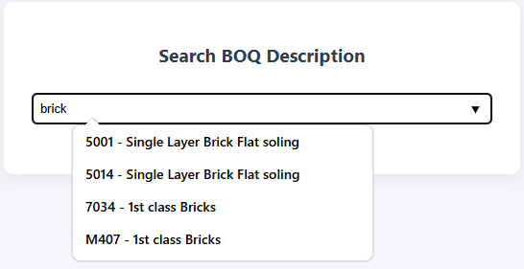
Workflow
User can select BOQ Description from the recommendations given by system.

Slide 8
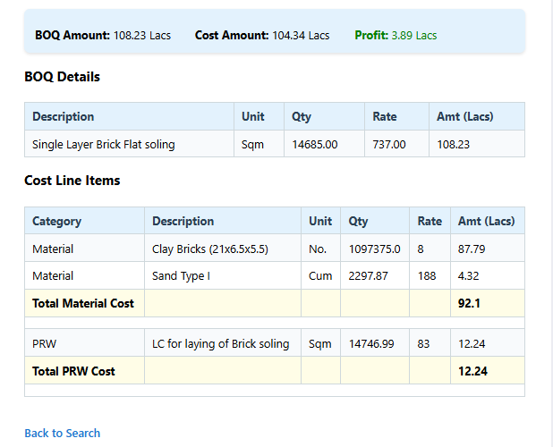
Workflow
System will generate a report showing BOQ Turn-over & its Cost line items ( Material Cost, S/C Cost, Equipment Cost, Manpower Cost).

Slide 9
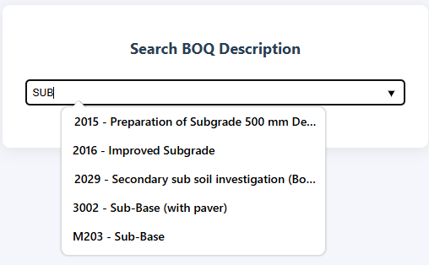
Workflow

Slide 10
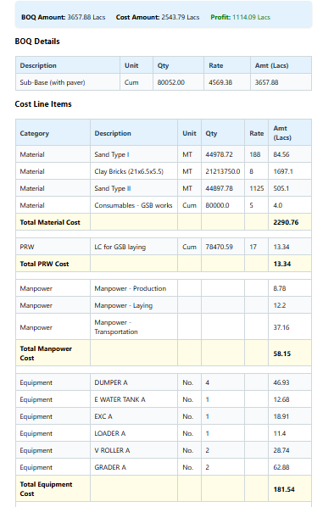
Workflow
Generated report showing BOQ Turn-over & its Cost line items (Material Cost, Sub - Contractor Cost, Equipment Cost) associated with Sub-Base. Detailed Material Type, No. of Equipments, S/C details will be provided on the Dashboard.

Slide 11
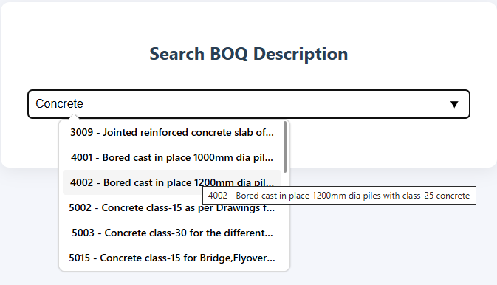
Workflow

Slide 12
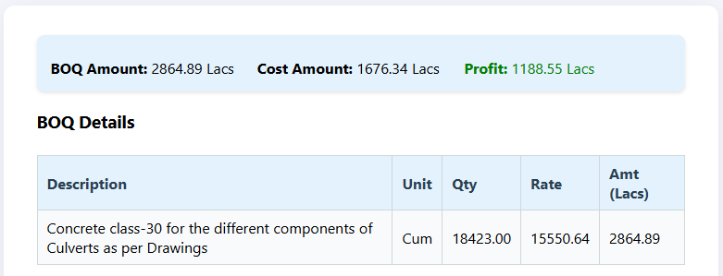
Workflow
Profit will be shown in Green Format.
Loss will be shown in Red Format.

Slide 13
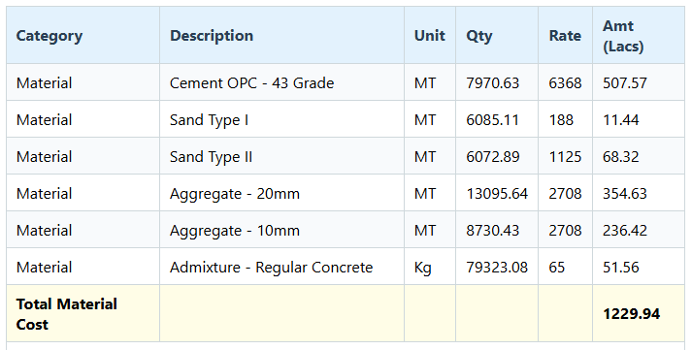
Workflow
Material Cost breakdown. It displays Total Quantity, Rate of Material & Total Amount.

Slide 14
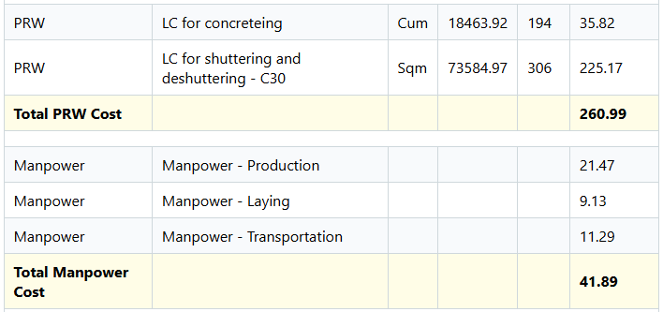
Workflow
Sub-Contractor & Manpower Cost breakdown. It displays Total Quantity, Rate of S/C & Total Amount.

Slide 15
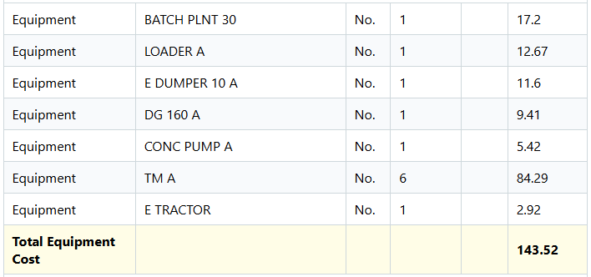
Workflow
Equipment Cost breakdown. It displays Total no. of equipments need to be deployed & Total Amount.

